Slide 1
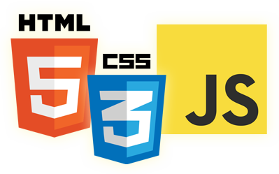


JavaScript Language
Eyal Vardi
Microsoft MVP ASP.NET blog: eyalvardi.wordpress.com

Slide 2
JavaScript History

Slide 3
In The Beginning...
In 1995 Netscape hired a young lad by the name of Brenden Eich to take charge of designing a new language.
Sun and ECMA decide to standardize JavaScript and create 'ECMAScript'.

Slide 4
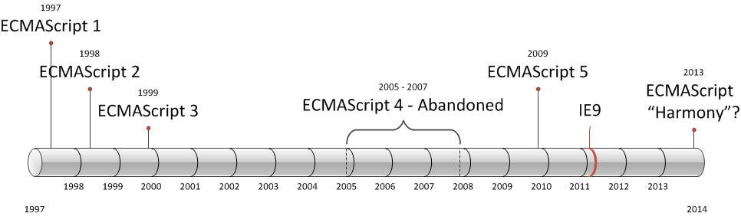
ECMAScript Versions

Slide 5
Data Types

Slide 6
Data Types
There are five simple data types (also called primitive types) in ECMAScript:
Undefined
Null
Boolean
Number
String
Object (unordered list of name-value pairs)

Slide 7
The typeof Operator
A typeof operator determine the data type of a given variable.
typeof undefined // "undefined"
typeof 0 // "number"
typeof true // "boolean"
typeof "foo" // "string"
typeof {} // "object"
typeof null // "object"
typeof function () { } // "function"
typeof NaN // "number"
official mistake
Functions are still objects.
Not-A-Number

Slide 8
The Undefined Type
When a variable is declared using var but not initialized, it is assigned the value of undefined
var message;
alert( message == undefined ); //true
alert(message); // "undefined"
// Make sure this variable isn’t declared var age.
alert(age); //causes an error
alert( typeof message ); //"undefined"
alert( typeof age ); //"undefined"

Slide 9
The Null Type
A null value is an empty object pointer, which is why typeof returns “object”
The value undefined is a derivative of null, so ECMA-262 defines them to be superficially equal.
var car = null;
alert(typeof car); //"object"
alert(null == undefined); //true

Slide 10
The Boolean Type
To convert a value into its Boolean equivalent, the special Boolean() casting function is called.
The if statement, automatically perform this Boolean conversion.
var message = "Hello world!";
if (message) {
alert("Value is true");
}

Slide 11
The Number Type
Number uses the IEEE-754 format to represent both integers and floating-point values.
var intNum = 55; //integer
var octalNum1 = 070; //octal for 56
var hexNum1 = 0xA; //hexadecimal for 10
var floatNum2 = 0.1;
var floatNum3 = .1; //valid, but not recommended
var floatNum1 = 1.; // interpreted as integer 1
var floatNum2 = 10.0; //whole number - interpreted as integer 10

Slide 12
Floating-Point Values
Accurate up to 17 decimal places but are far less accurate in arithmetic computations than whole numbers.
For instance, adding 0.1 and 0.2 yields 0.30000000000000004 instead of 0.3.
if (a + b == 0.3){ //avoid!
alert("You got 0.3.");
}

Slide 13
Range of Values
Number.MIN_VALUE = 5e-324
Number.MAX_VALUE = 1.7976931348623157e+308
Infinity = Out of range
NaN - Not a Number
alert( NaN == NaN ); //false
alert( isNaN(NaN) ); //true
alert( isNaN(10) ); //false
alert( isNaN("10") ); //false
alert( isNaN("blue") ); //true
alert( isNaN(true) ); //false

Slide 14
Number Conversions
There are three functions to convert nonnumeric values into numbers:
Number() --> Any data type to number
parseInt() --> string to number
parseFloat() --> string to number
var num1 = Number("Hello world!"); //NaN
var num2 = Number(""); //0
var num3 = Number("000011"); //11
var num4 = Number(true); //1
var num1 = parseInt("1234blue"); //1234
var num2 = parseInt(""); //NaN
var num3 = parseInt("0xA"); //10 - hexadecimal
var num4 = parseInt(22.5); //22
var num5 = parseInt("70"); //70 - decimal
var num6 = parseInt("0xf"); //15 - hexadecimal

Slide 15
The String Type
Represents a sequence of zero or more 16-bit Unicode characters.
Strings are immutable in ECMAScript, meaning that once they are created, their values cannot change.
var firstName = "Eyal";
var lastName = 'Vardi';
"a string" == "a string"

Slide 16
Reference Types
A reference value (object) is an instance of a specific reference type.
ECMAScript provides a number of native reference types, such as Object.
Object
Function
Array
Date
Regexp
Wrapper Types

Slide 17
The Object Type
There are two ways to explicitly create an instance of Object.
new operator
Object literal
var person = {};
//same as
var person = new Object();
var person = {
name : "Nicholas",
age : 29
};

Slide 18
Dynamic Properties
With reference values, at any time you can:
add, change, or delete properties and methods.
// Reference Type
var person = new Object();
person.name = "Nike";
person['name'] = "Hi";
alert(person.name); //"Hi"
// Primitive Type
var name = "Nicholas";
name.age = 27;
alert(name.age); //undefined

Slide 19
Object Properties & Methods
Each Object instance has the following properties and methods:
Constructor
hasOwnProperty(propertyName)
isPrototypeOf(object)
propertyIsEnumerable(propertyName)
toLocaleString()
toString()
valueOf()

Slide 20
Primitive Wrapper Types
Every time a primitive value is read, an object of the corresponding primitive wrapper type is created behind the scenes, allowing access to any number of methods for manipulating the data.
Boolean, Number & String
var s1 = "some text";
var s2 = s1.substring(2);
var t = new String("some text");
var s2 = t.substring(2);
t = null;

Slide 21
Primitive Wrapper Lifetime
A reference type using the new operator, it stays in memory until it goes out of scope.
Primitive wrapper objects exist for only one line of code before they are destroyed.
Calling typeof on an instance of a primitive wrapper type returns “object”.
var s1 = "some text";
s1.color = "red";
alert(s1.color); //undefined

Slide 22
The Boolean Wrapper
All primitive wrapper objects convert to the Boolean value true.
var falseObject = new Boolean(false);
var result = falseObject && true;
alert(result); //true
var falseValue = false;
result = falseValue && true;
alert(result); //false

Slide 23
The Function Type (Object)
First class object
Can be defined inside other functions.
Functions stored in objects
Functions that don’t specify a return value actually return the special value undefined.
function foo() {}
// Option 2
var foo = function foo() {};
// Option 3
var foo = new Function( [argname1, [... argnameN,]] body );

Slide 24
Arguments
An ECMAScript function doesn’t care how many arguments are passed in, nor does it care about the data types of those arguments.
This happens because arguments in ECMAScript are represented as an array internally.
An arguments object that can be accessed while inside a function to retrieve the values of each argument that was passed in.
function sayHi() {
alert("Hello " + arguments[0] + ", " + arguments[1] );
}

Slide 25
Arguments Example
function doAdd() {
if (arguments.length == 1) {
alert(arguments[0] + 10);
} else if (arguments.length == 2) {
alert(arguments[0] + arguments[1]);
}
}
doAdd(10); //20
doAdd(30, 20); //50

Slide 26
No Overloading
ECMAScript functions cannot be overloaded in the traditional sense.
function addSomeNumber(num) {
return num + 100;
}
function addSomeNumber(num) {
return num + 200;
}
var result = addSomeNumber(100); //300

Slide 27
Function Properties & Methods
length
prototype
apply()
call()

Slide 28
Function Length Property
function sayName(name){ alert(name); }
function sum(num1, num2){ return num1 + num2; }
function sayHi() { alert("hi"); }
alert( sayName.length ); //1
alert( sum.length ); //2
alert( sayHi.length ); //0

Slide 29
Operators

Slide 30
Unary Plus and Minus
The unary plus is represented by a single plus sign (+) placed before a variable and does nothing to a numeric value.
When the unary plus is applied to a nonnumeric value, it performs the same conversion as the Number() casting function.
var num = 25;
num = +num; //still 25

Slide 31
Unary Plus and Minus
var s1 = "01";
var s2 = "1.1";
var s3 = "z";
var b = false;
var f = 1.1;
var o = {
valueOf: function() {
return -1; }
};
s1 = +s1; //value becomes numeric 1
s2 = +s2; //value becomes numeric 1.1
s3 = +s3; //value becomes NaN
b = +b; //value becomes numeric 0
f = +f; //no change, still 1.1
o = +o; //value becomes numeric -1

Slide 32
Boolean Operators
! expr
Returns false if its single operand can be converted to true; otherwise, returns true.
expr1 && expr2
Returns expr1 if it can be converted to false; otherwise, returns expr2. Thus, when used with Boolean values, && returns true if both operands are true; otherwise, returns false.
expr1 || expr2
Returns expr1 if it can be converted to true; otherwise, returns expr2. Thus, when used with Boolean values, || returns true if either operand is true; if both are false, returns false.

Slide 33
Boolean Operators
alert(!"blue"); //false
alert(!""); //true
alert(!0); //true
alert(!NaN); //true
alert(!12345); //false
a5 = "Cat" && "Dog" // t && t returns Dog a6 = false && "Cat" // f && t returns false a7 = "Cat" && false // t && f returns false
o5 = "Cat" || "Dog" // t || t returns Cat o6 = false || "Cat" // f || t returns Cat o7 = "Cat" || false // t || f returns Cat

Slide 34
Equality Operators
Performed conversions into like types before doing a comparison.
Not equal because different data types
7 == "7" // true
7 === "7" // false

Slide 35
Strict Mode
ECMAScript 5 introduced the concept of strict mode.
Strict mode helps out in a couple ways:
It catches some common coding bloopers, throwing exceptions.
It prevents, or throws errors, when relatively “unsafe” actions are taken (such as gaining access to the global object).
It disables features that are confusing or poorly thought out.
"use strict";
function doSomething(){
"use strict";
//function body
}

Slide 36
Thanks
eyalvardi.wordpress.com
Eyal Vardi
Microsoft MVP ASP.NET blog: eyalvardi.wordpress.com

